Slide 1
Wavelet phase estimation without accurate time-depth conversion
Jiangbo Yu
Advisor: Dr. John Castagna
AGL update meeting
May 2, 2012

Slide 2
content
Introduction
Theory
Results
Conclusion

Slide 3
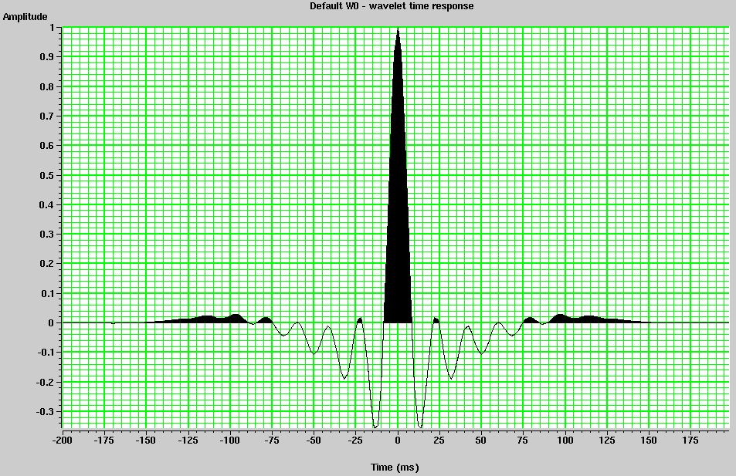
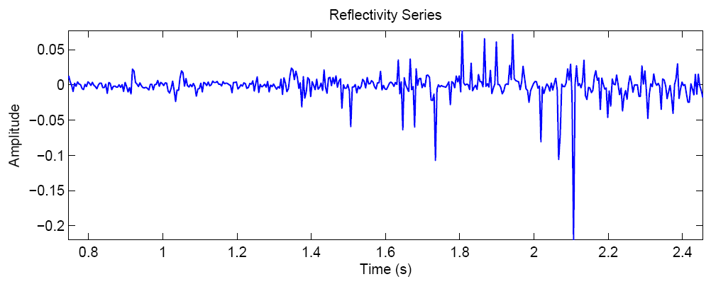
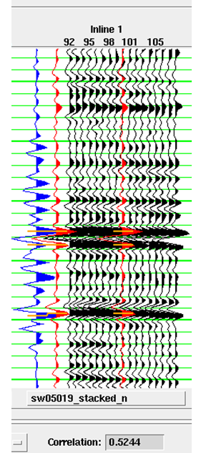
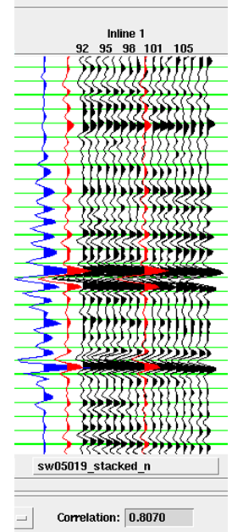
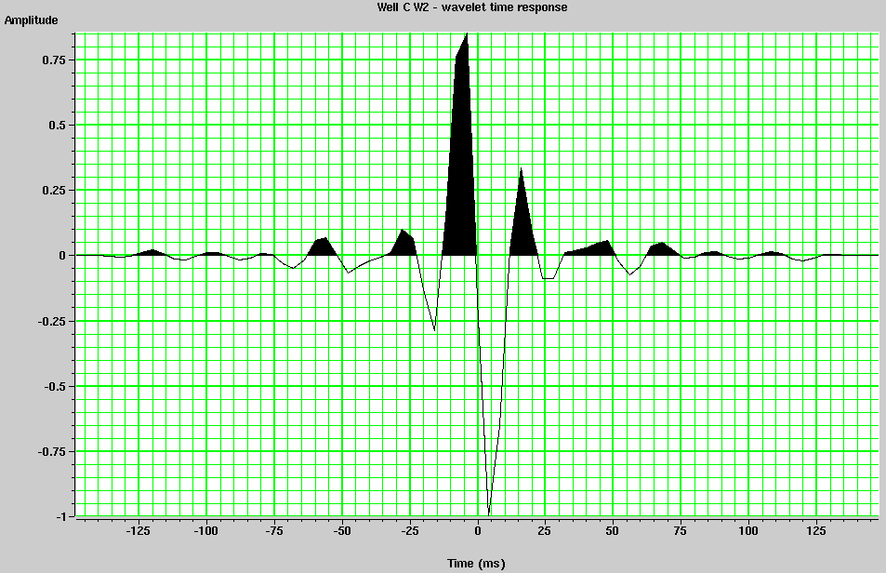
Introduction-Seismic-TO-well-tie
CONVOLUTION
Statistical wavelet from seismic
Reflectivity series from well logs
Phase rotate wavelet until maximum correlation is found
QC initial tie
Final tie
Edgar and van der Baan, 2009
Notes:
One of the best ways to tie seismic data back to a ‘ground truth’ is to correlate seismic to well log

Slide 4
Problems of sonic log calibration
P-wave velocity from sonic log is different with seismic velocity
Short logging runs, or gaps in sonic log coverage
Inaccurate time-depth conversion
Aggressively forcing a well tie will affect the estimated wavelet
Notes:
The link between seismic travel time and depth from the well log could be wrong

Slide 5
Theory-- histogram matching phase estimation
1. Zero-phase wavelet estimation

Slide 6
Theory – Histogram matching
2. Frequency domain deconvolution

Slide 7
Theory – Histogram matching
Estimated wavelet
True wavelet

Slide 8
Theory – Histogram matching
Assumption:
Major part of the difference between inverted reflectivity amplitude distribution with well log derived reflectivity amplitude distribution is caused by the incorrect phase of wavelet
Advantage:
Will not be affected by inaccurate time-depth conversion

Slide 9
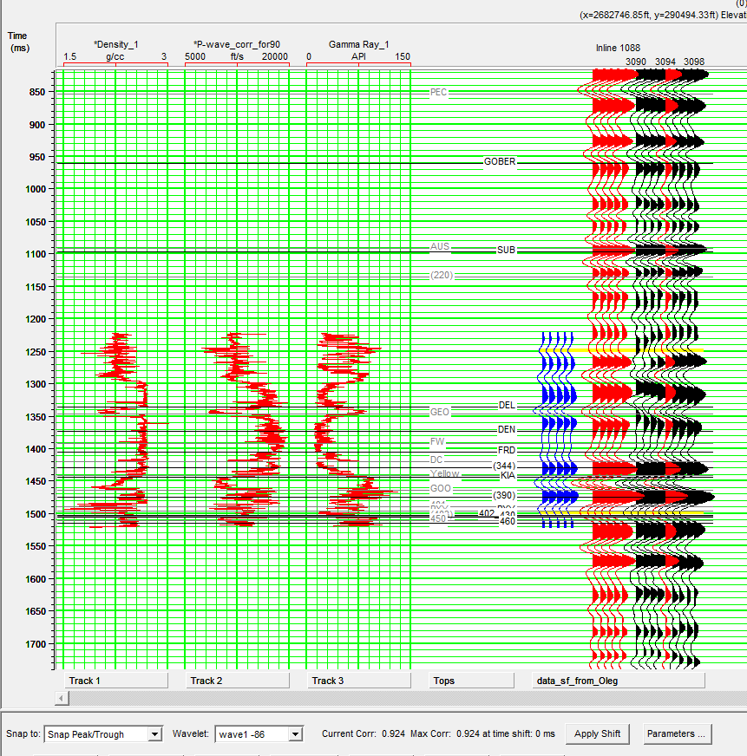
Real data
Correlation:0.924

Slide 10
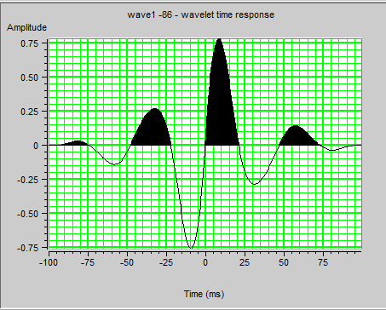
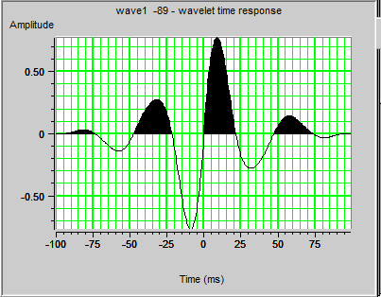
Real data
Estimated from seismic-to-well tie (-86 degree)
Estimated from histogram matching (-89 degree)

Slide 11
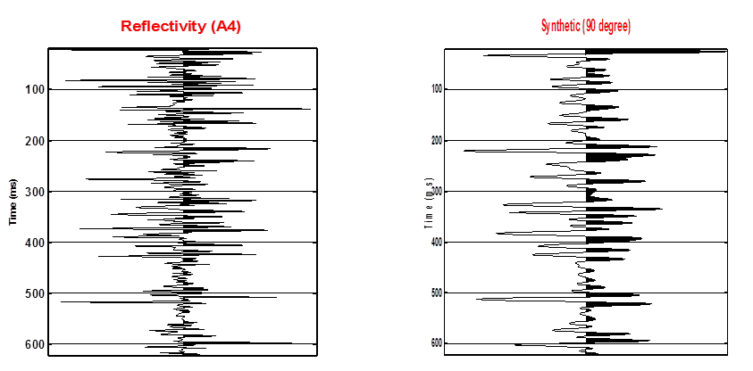
Result– Real reflectivity

Slide 12
Result– accurate time-depth conversion
True wavelet
Histogram matching
Wiener filter

Slide 13
Result– Bulk shift
True wavelet
Histogram matching
Wiener filter

Slide 14
Result– Dynamic shift
True wavelet
Histogram matching
Wiener filter

Slide 15
Conclusion
Inaccurate time-depth conversion will affect seismic wavelet estimation through well-tie
Histogram matching could estimate wavelet phase correctly even with a wrong time-depth conversion

